Slide 1


Data Processing Project
Due 27/06/2021
Boutique sales products Analysis

Slide 2
This project is presented by :
VALCIN Pierry
Finance| Data Analyst

Slide 3
Table of content
01
Introduction
02
Problem
03
Methodology
04
Results
05
Discussions & Proposed solutions
06
References & Appendices

Slide 4
Introduction
This project is written as part of a python data processing assignment, in which we was asked to draw out insights as a Data Analyst for Ayiti Analytics from the data they collected on the applicants for their bootcamp.

Slide 5

Problem
What is the business problem?
Ayiti Analytics wants to extend their training centers in 3 new communes in Haiti and also need to know how can they have more women enroll in their bootcamps. The problem is they do not know which communes that will be the most susceptible to implement the Bootcamp.

Slide 6
Problem
Who are the stakeholders impacted by the problems?
The stakeholders affected by this problems are :
The Executive boards of Ayiti Analytics that can’t decide where to extend their training centers
The applicants that needs to gather in Port-au-Prince commune, with all the security risks in a 4 month long bootcamp could impact their productivity
Ayiti Analytics Sponsors : Knowing how and where AA will extend itself in the future could impact the relationship with them.

Slide 7
Problem
Why is this problem important to the organization?
The problem is important to the organisations because AA wants to cover more area in Haiti with their services and training in data science they are providing. Being able to reach communes that have ease of access to computer and internet would make the process more easier.

Slide 8
Methodology
To realized this project, we used:
Ayiti analytics Datasets that includes questionnaire forms data ,course enrollment,number of Transactions and industry/study domain
The main tool we used for the data processing is Python. We used it to do the merging of the dataset, data cleaning and also data visualization.
Our approach is Diagnostic Analysis to provide a more in-depth analysis to answer several questions asked by the Executive Boards

Slide 9
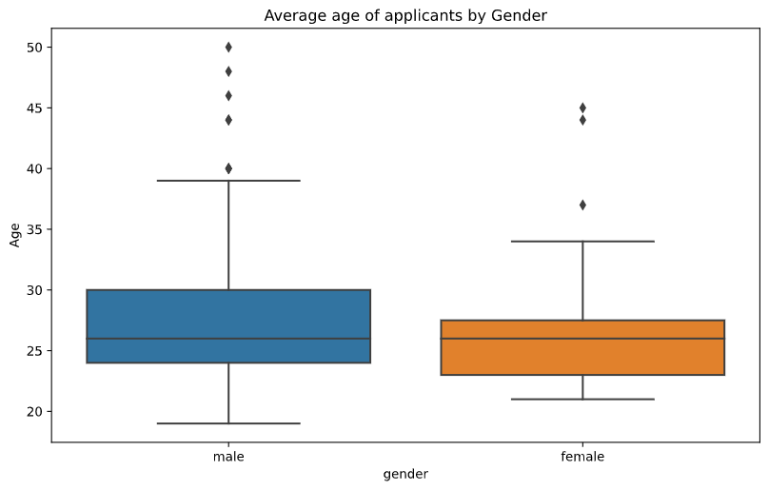
The average of the student’s age by gender
In total from the dataset , we had 250 applications for the 2021 Bootcamp of which 207 males and 43 females with an average age of 27.6 years and 26.44 years respectively.
Women represented 17.2% of the total applicants

Slide 10
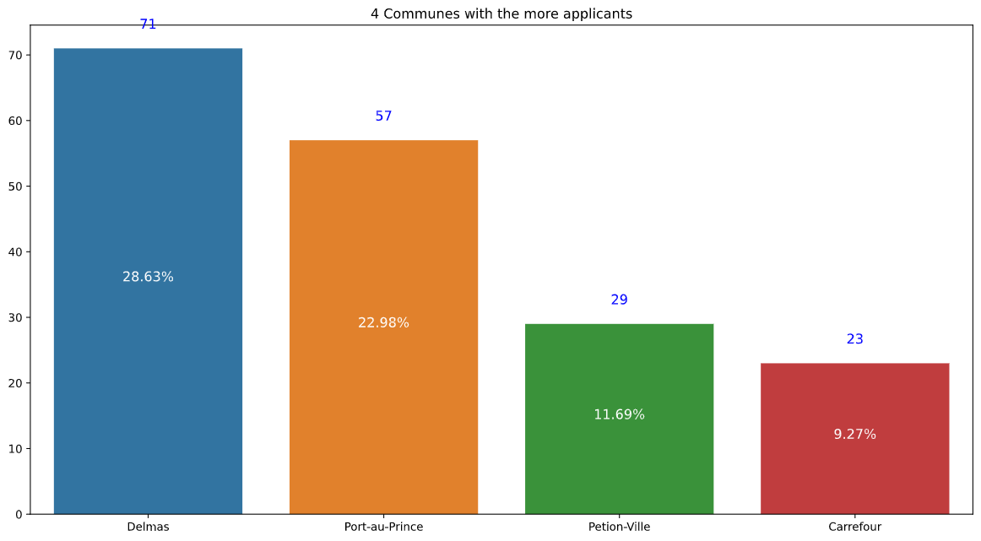
Communes with the most applicants
Besides Port-au-Prince where the first training center is located, Delmas,Petion-ville and Carrefour were the others communes with the most applicants

Slide 11
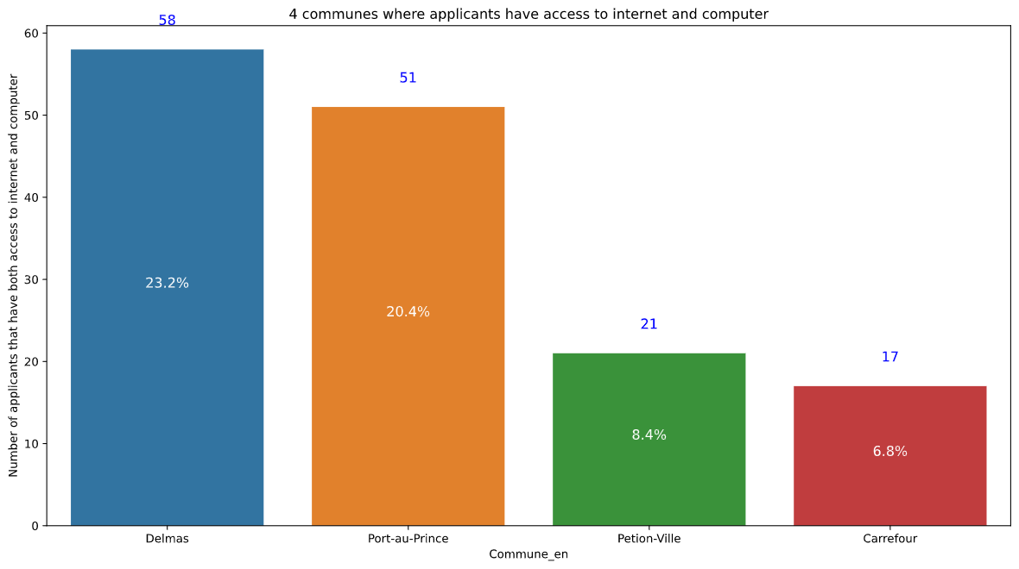
Communes with the most applicants with access to internet and computer at the same time
Besides Port-au-Prince where the first training center is located, Delmas,Petion-ville and Carrefour with the most applicants who has access to laptop and internet

Slide 12
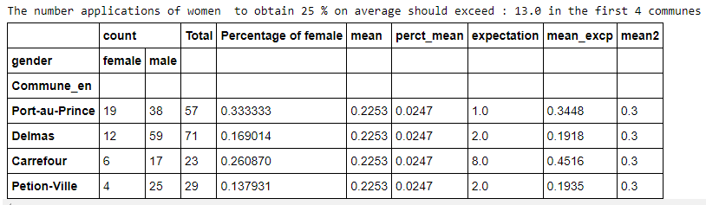
Q1 - How many applications must be made to select 25% women for each on average ?
1- To obtain an average of 25 % women, for each cohort, 30 students should be selected. Our hypothesis is that the next applications receive should be a woman We would need at least 13 applications to meet the goal in the 3 communes beside P-au_p. Carrefour would need 8 more application of women for the criteria of 30 student per cohort.

Slide 13
Q1 - How many applications must be made to select 25% women for each on average ? Part 2
To obtain this result, our hypothesis was to obtain only females applications for the first 4 communes to be able to reach the target mean of 25 % on average. We find that the average of women by application was set at 22.5 %. Our goal was short to only 2.5% which represented at least 5 more applications of women for the bootcamp to obtain 25% on average.

Slide 14
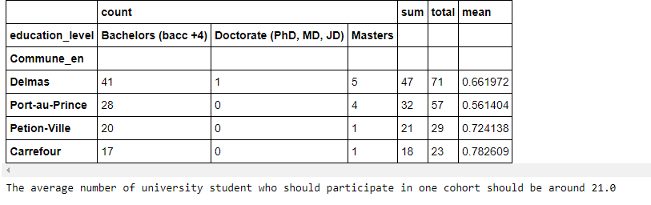
Q2 - What is the average number of university students who should participate in this program ?
To get this result, we calculate the average of the mean of all the university levels applicant in each commune.Then we use the proportion to find what the expected number of university level applicants in one cohort

Slide 15
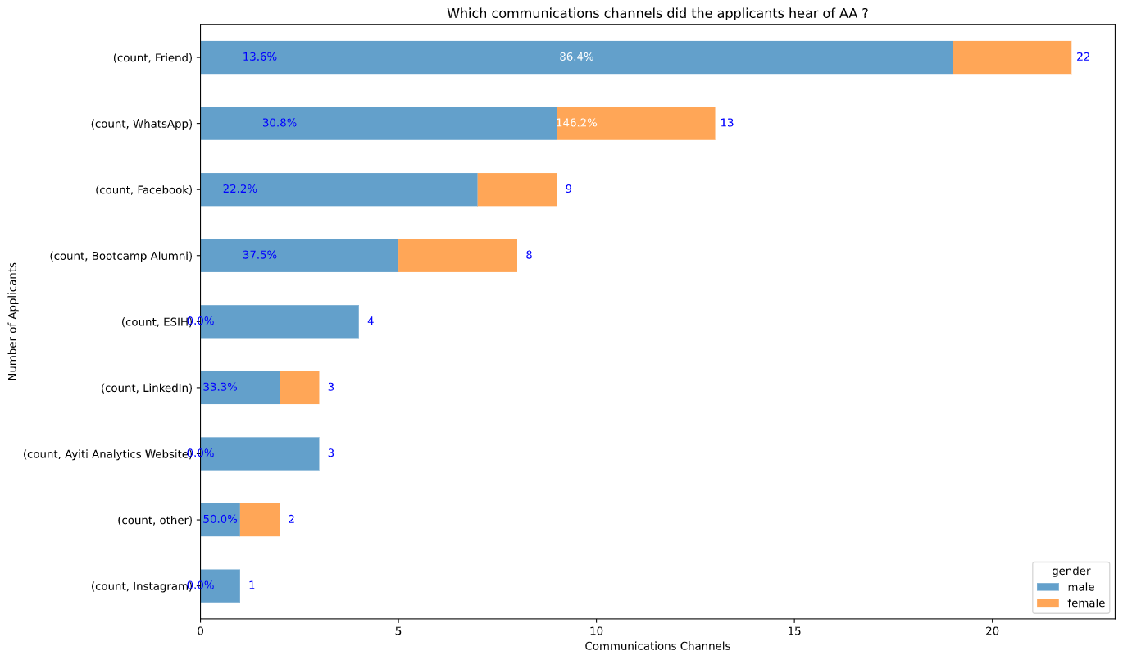
Which communications channels did the applicants that enroll for the course hear of AA ?
In this graph, we can see how Friend and Whatsapp are leading as communication channels that are the most effective We did our analysis on the number of people that paid to enroll to next step. But to confirm our findings , later on we will test statistically our hypothesis with a Chi-Square test.
We consider The applicants that paid to be the most susceptible to selection.

Slide 16
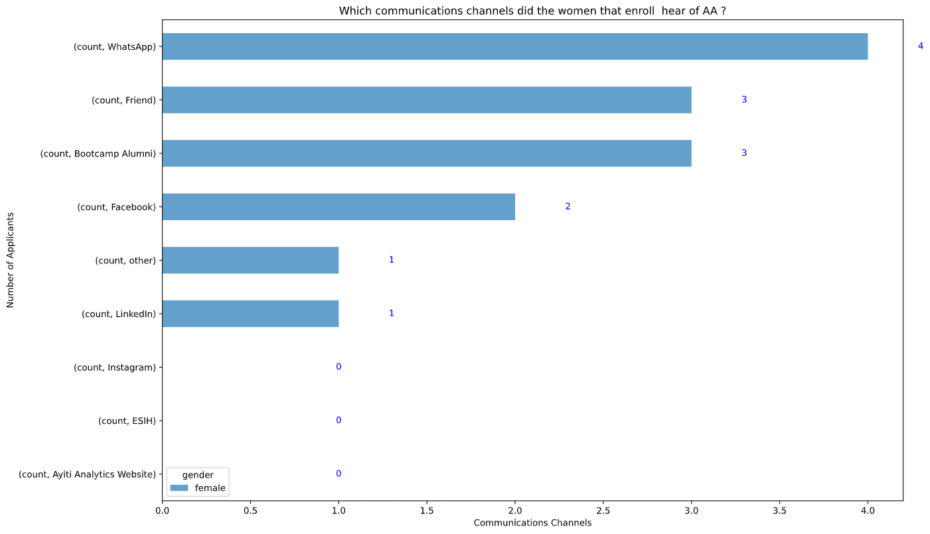
Which communications channels did the women that enroll for the course hear of AA ?
In this graph, we can see how Friends,Whatsapp and bootcamp alumni are leading as communication channels that are the most effective for a women to paid to enroll in the course for selection. But to confirm our findings ,later on we will test statistically our hypothesi Chi-Square test.

Slide 17
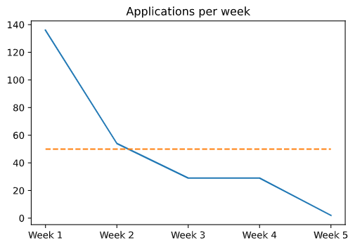
- What will be the average number of applications per week that we could have ?
The average number of applications per week should be 50.0

Slide 18
Discussion & Proposed Solution
Based on the insights provided by the data processing we did , we can come up with several proposals solutions for Ayiti Analytic’'s problems.
Solution 1
Extend their Training centers to Delmas,Carrefour and Petion-ville
Solution 2
Do an online bootcamp

Slide 19
Proposed Solution 1
Extend their Training centers to Delmas,Carrefour and Petion-ville
Find Very good addition to the dynamic team of AA to help them manage the training centers at the same rythmn.
Find sponsor and new partenership to gave an internship to 120 possible new graduates by cohort
The applicants of theses 3 communes had the most access to internet and computer at home
The applicants of theses 3 communes where the one most suceptible to be selected
Weakness
Challenges
Strength
The cost of the extension(bigger team,new investment in training centers,Setting up a lab)
the growing insecurity in the cities near the Capital of P-au-P

Slide 20
Proposed Solution 2
Do an online bootcamp.
Strength
Don’t need to Extend the team.
No new Local required
Electricity/internet access very poor in haiti
Difficulty Staying Motivated for participants
Weakness
Challenges
Facing technical issues in Haiti

Slide 21
Recommendations
We recommend that Ayiti Analytics extend their training centers in Delmas, PEtion-ville and Carrefour. These communes has the highest access to internet/Computer from the application form data. The number of select participants will be around 120 with more than 60 % of the applicant could be university levels. This will mean more connections and more possibilities
0

Slide 22
THANKS
Contact Us
I you have any question about this presentation, Feel free to send us a message in the #help-python channel on slack.
Ressources
See the full project
Data Analysis Method

